Slide 1
Yazhini B
Name :
Register number:
2426j0519
NM ID :
E899C3A7FBDE7DBBB43435F386E349A0
DEPARTMENT:
INFORMATION TECHNOLOGY
COLLEGE:
SRI KRISHNA ADHITYA COLLEGE OF ARTS AND SCIENCE

Slide 2
PROJECT TITLE:
WEB-BASED
Smart Agriculture using iot

Slide 3
AGENDA :
1.Problem Statement
2.Project Overview
3.End Users
4.Tools and Technologies
5.Portfolio design and Layout
6.Features and Functionality
7.Results and Screenshots
8.Conclusion

Slide 4
PROBLEM STATEMENT:
Agriculture is the backbone of our economy, but farmers face major challenges such as water scarcity, unpredictable weather, soil degradation, and inefficient use of resources. Traditional farming methods do not provide real-time data about soil and environmental conditions, which often leads to reduced productivity and crop failure. There is a need for an intelligent system that uses IoT technology to help farmers monitor and manage resources efficiently.

Slide 5
Project overview:
This project aims to develop a Smart Agriculture System using IoT that collects data from sensors such as soil moisture, temperature, and humidity. The collected data is analyzed and displayed to farmers in real time, enabling informed decision-making. Automated irrigation ensures optimal water usage, improving productivity and sustainability.

Slide 6
End users :
👨‍🌾 Farmers – to improve crop productivity and reduce manual monitoring.
🏢 Agricultural research institutions – to analyze farming trends and optimize practices.
🌍 Government & NGOs – for implementing smart farming initiatives.
📱 Agritech startups – to develop farmer-friendly applications and services.

Slide 7
Tools and technologies:
Frontend: HTML, CSS, JavaScript
IoT Sensors: Soil moisture sensor, DHT11/DHT22 for temperature & humidity
Microcontroller: Arduino/NodeMCU (ESP8266/ESP32)
Cloud Platforms: ThingSpeak, Firebase, or AWS IoT Core for data storage
Programming Languages: C/C++ for microcontroller, JavaScript for frontend
Visualization: Web dashboard and mobile-friendly UI

Slide 8
Features and functionality:
🌱 Real-time monitoring of soil moisture
🌡️ Temperature and humidity tracking
💧 Automated irrigation control based on soil condition
📊 Graphical data visualization on a web dashboard
📱 Remote monitoring from any device
🔔 Alerts/notifications for abnormal conditions
—

Slide 9
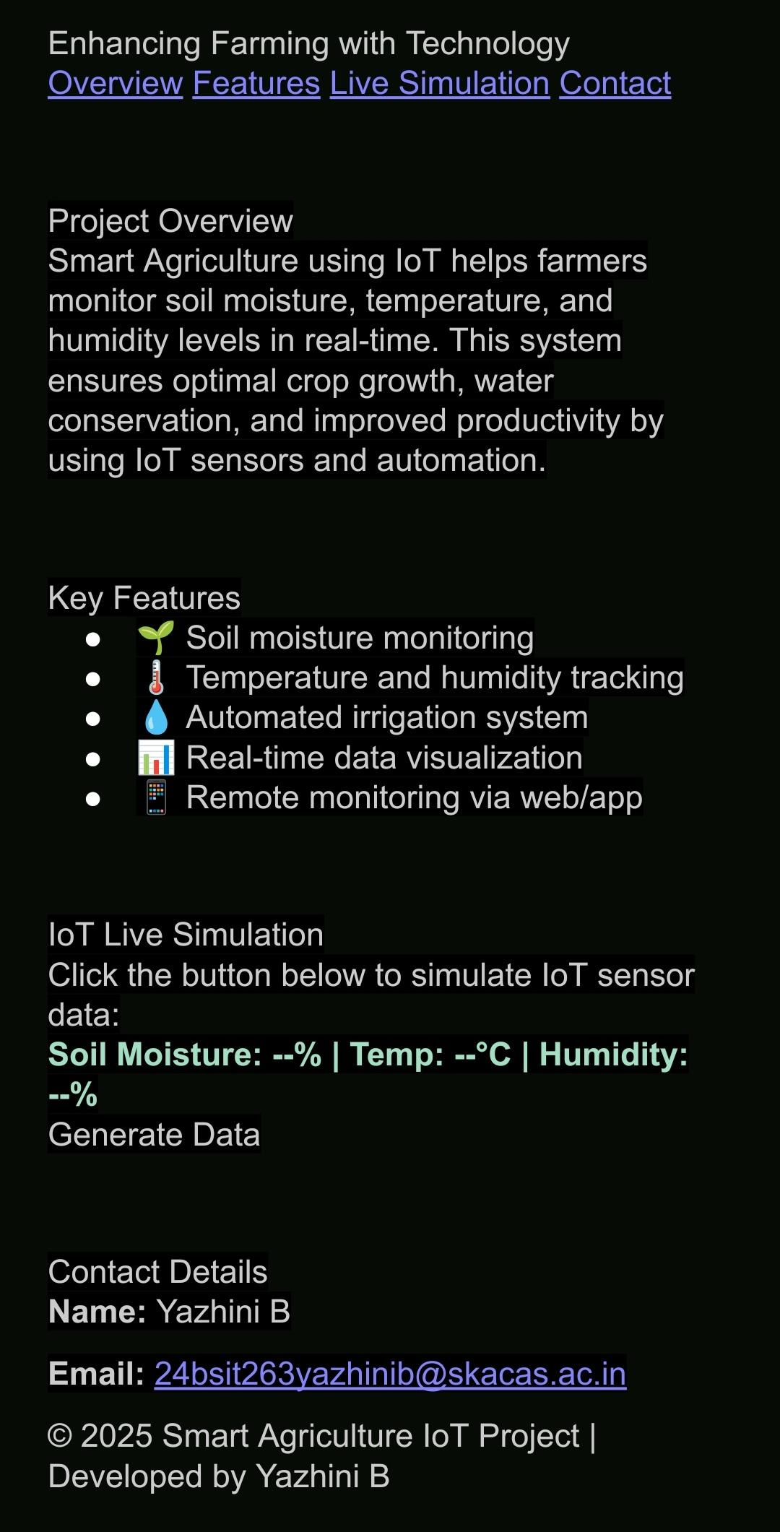
Result:

Slide 10
Conclusion:
The Smart Agriculture using IoT system demonstrates how technology can revolutionize farming by reducing resource wastage, improving crop yields, and enabling data-driven farming practices. This project is scalable, cost-effective, and highly beneficial for sustainable agriculture, helping farmers adapt to modern smart farming techniques

Slide 11
GitHub link:
https://github.com/24bsit263yazhinib-bot/TNSDC_FWD_DIGITAL_PORTFOLIO.git

Slide 12
THANKYOU

